Slide 1
Inventra – Intelligent Inventory Management System
Milestone 1
BY
Prathyusha Yekamba

Slide 2
Meaning of the Title
Inventra
“Invent” → Inventory
“Tra” → Tracking
The name represents an intelligent, automated platform for tracking inventory, stock movements, alerts, and analytics.
Meaning:
Inventra is a smart system that manages stock, predicts shortages, tracks movement, and automates alerts, ensuring efficient inventory control.

Slide 3
Existing System
Problems in Traditional Inventory Systems
Mostly manual and paper-based.
High chances of human error.
No real-time stock visibility.
No forecasting → leads to overstock or stockouts.
Poor communication between departments.
No automated alerts for expiry, reorder level, or shortages.
Time-consuming stock audit.

Slide 4
Proposed System
Proposed System – Inventra
Fully automated, software-driven inventory tracking
AI-based demand forecasting
Real-time stock updates and movement history
Automated alerts for:
  Low stock
  Expiry near
  Fast/slow-moving items
Detailed analytics and reports

Slide 5
Modules of Inventra
Authentication – Login, token generation, role validation
Product / Inventory Management – Add, update, remove items, manage stock levels
Inventory Alerts – Low stock, expiry alerts, fast/slow moving items
Reports & Analytics – Charts, predictions, insights

Slide 6
Working of Each Module
Authentication Module
Validates username & password
Generates secure session tokens
Allows access based on user roles (Admin/Manager/Staff)
Product / Inventory Management
Add new items to inventory
Update item quantity, expiry date
Track stock-in & stock-out
Store supplier and purchase details

Slide 7
Inventory Alerts Module
Checks stock quantity automatically
Triggers low stock alerts
Warns when expiry date is near
Identifies slow or fast-moving items
Reports & Analytics Module
Generates graphical reports
Shows purchase/sales patterns
Predicts demand
Exportable reports for audit

Slide 8
System Configuration
Hardware Requirements
Processor : Intel i3 or above
RAM : 4 GB or more
Hard Disk : 20 GB
Monitor, Keyboard, Mouse
Software Requirements
Operating System : Windows / Linux
Backend : Node.js / Java
Database : MySQL / MongoDB
Tools : VS Code, Postman
Server : Localhost / Cloud Hosting

Slide 9
Classes
User – Represents user data stored in the database
AuthController – Exposes API endpoints like /login, /register
AuthService – Handles authentication logic & error handling
JwtProvider – Generates secure tokens for sessions
UserRepository – Performs CRUD operations on user data

Slide 10
Uses of Each Class
User
Stores username, password, email, role
Mapped to database table
AuthController
Receives login requests
Sends responses to frontend
Connects service → UI
JwtProvider
Creates and verifies JSON Web Tokens
Ensures secure login sessions
AuthService
Validates user credentials
Encrypts passwords
Handles login/logout functionality
UserRepository
Manages user database operations
Insert / Update / Delete / Fetch users

Slide 11
Database Schema
Field | Type | Description
userid | Primary Key | Unique user ID
username | Varchar | Unique username
email | Varchar | Email address
password | Varchar | Encrypted password
role | Varchar | Admin / Manager / Staff
is_active | Boolean | Account status

Slide 12
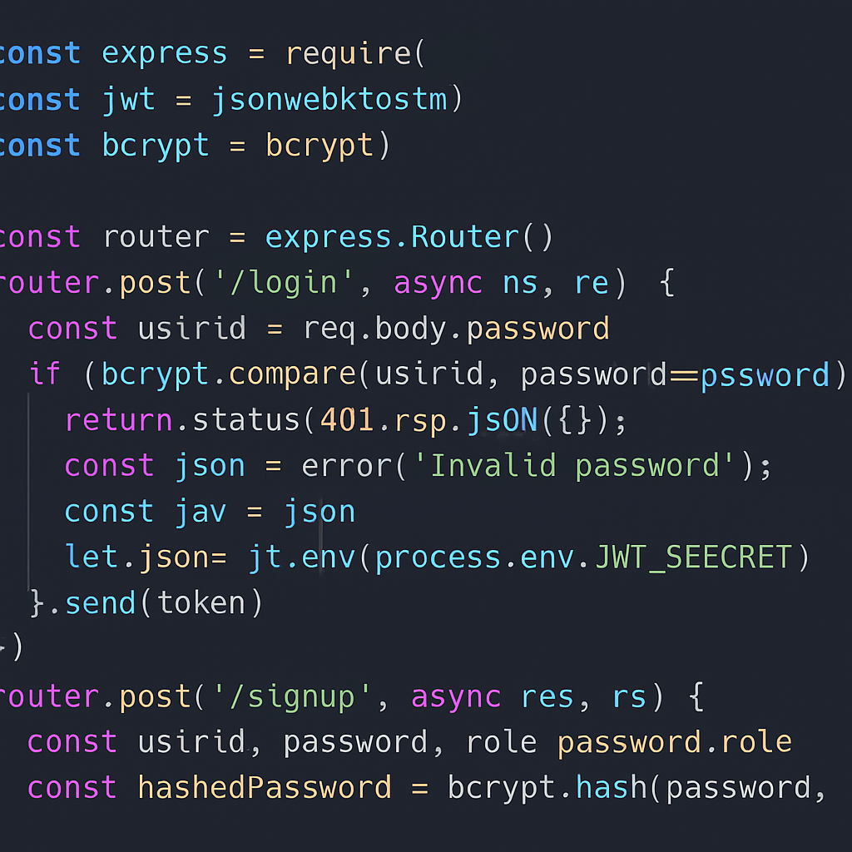
Explanation of the Code
This code handles login and signup in Node.js.
It imports express, jwt, and bcrypt.
For login, it checks the user’s password using bcrypt.compare() and generates a JWT token.
For signup, it hashes the password using bcrypt.hash() and saves the new user.

Slide 13
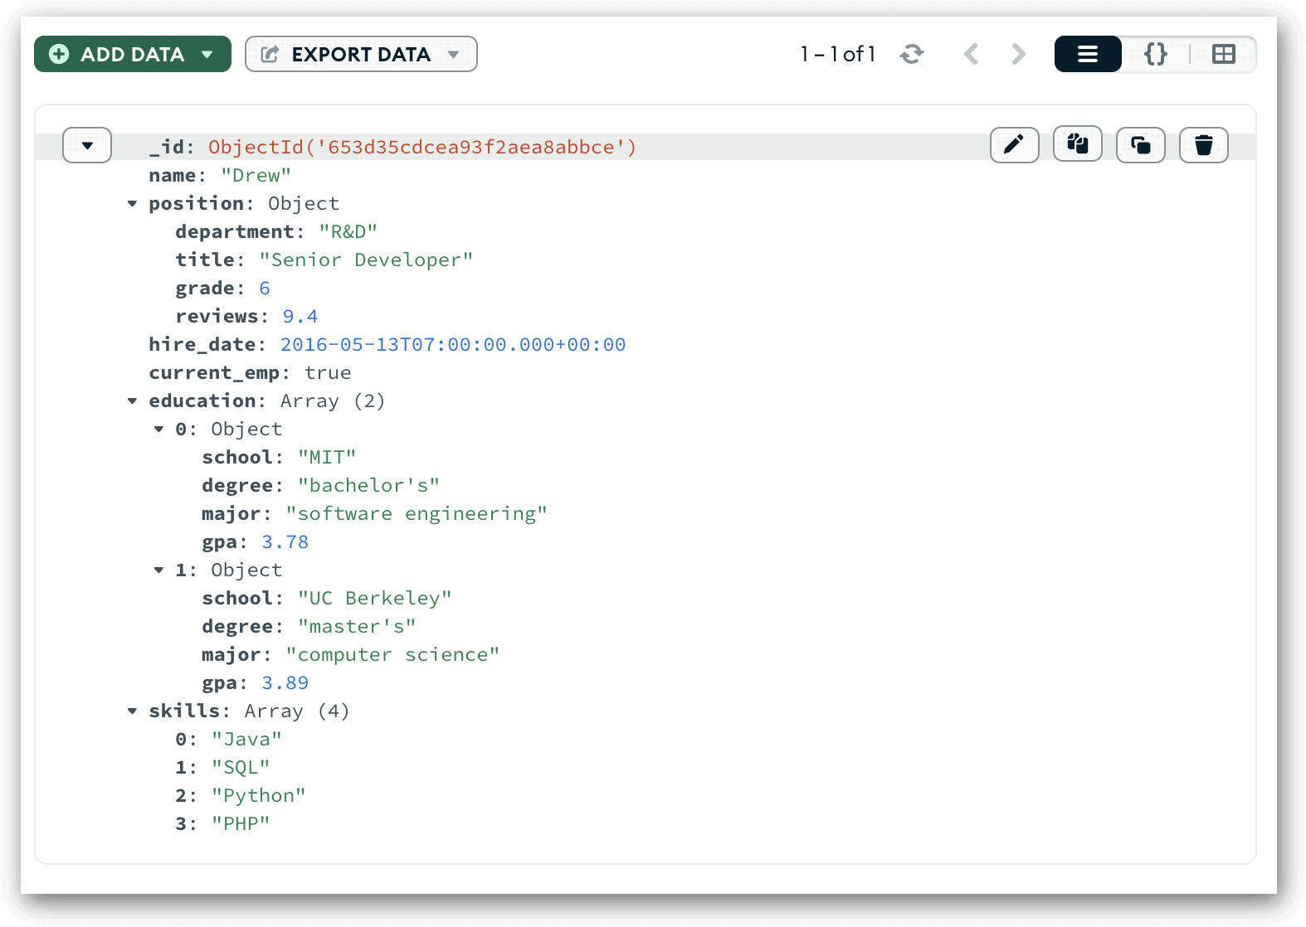

Slide 14
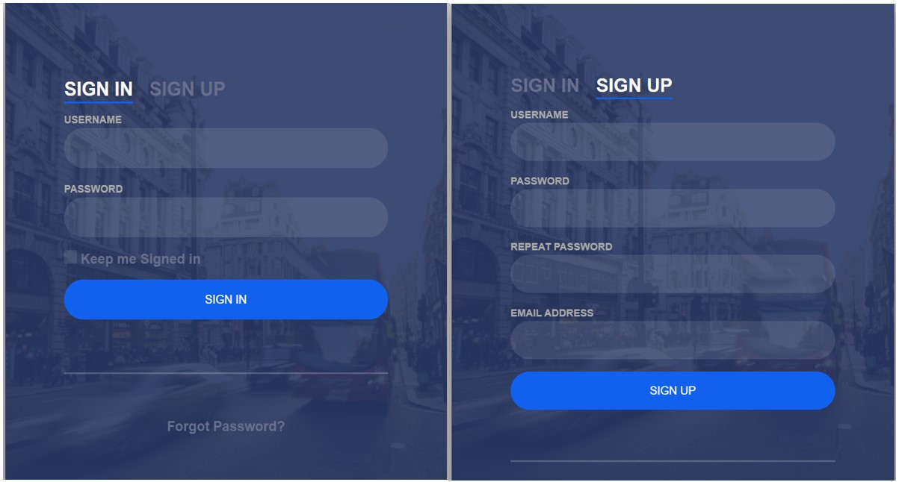
Login Output

Slide 15
Inventra – Intelligent Inventory Management System
Milestone 2

Slide 16
MODULE 2 INTRODUCTION
Module 2: Product / Inventory Management
This module manages:
Product details
Stock quantity
Supplier information
It ensures accurate and consistent inventory management.

Slide 17
AUTHENTICATION MODULE
Authentication Module Purpose
Secure system access
Validate user identity
Prevent unauthorized access
Generate secure session tokens

Slide 18
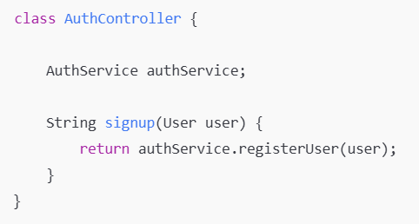
SIGN UP CONTROLLER
Receives registration data from UI
Forwards request to service layer
No business logic written here

Slide 19
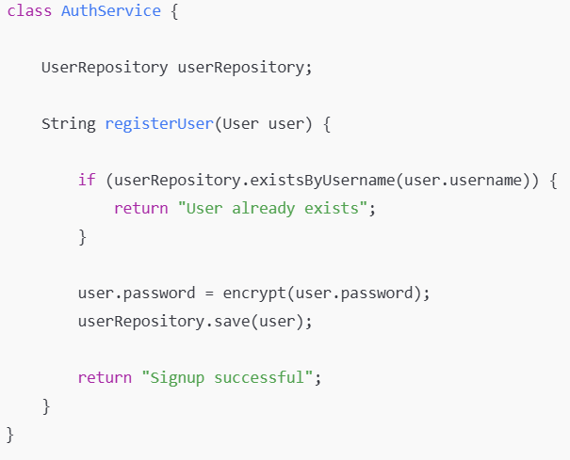
SIGN UP SERVICE

Slide 20
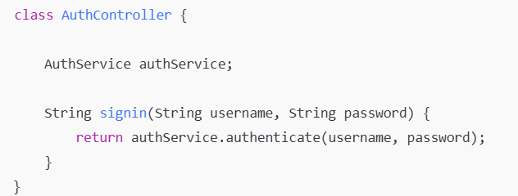
SIGN IN CONTROLLER

Slide 21
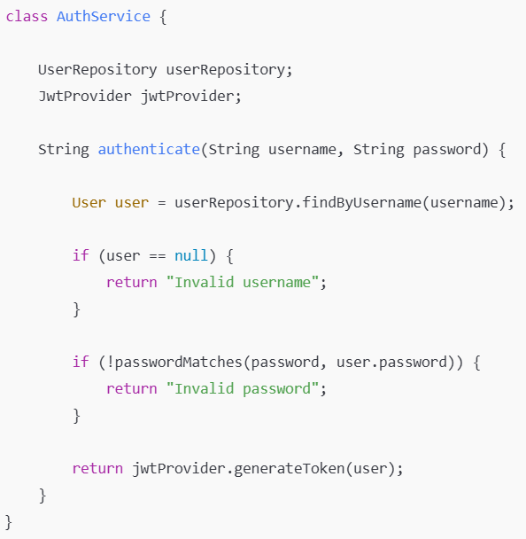
SIGN IN SERVICE

Slide 22
PURPOSE OF MODULE 2
The primary purpose of Module 2 is to provide a structured and automated way to manage inventory. It allows users to add new products, update stock levels during stock-in and stock-out operations, and prevent duplicate product entries.
This module ensures that inventory data is always:
Accurate
Consistent
Updated in real time
By using Java and Spring Boot, the module enforces business rules at the service level and maintains clean separation between layers, which makes the system scalable and maintainable.

Slide 23
PRODUCT CLASS
The Product class represents a real-world product in the system and acts as an entity mapped to a database table. It contains all the necessary attributes required to manage inventory effectively.
Key attributes include:
SKU, which uniquely identifies a product and prevents duplication
Stock Quantity, which tracks the available quantity of the product
Min StockLevel, which is used to trigger low stock alerts
By modeling the product as a Java entity, the system ensures seamless interaction with the database through JPA, enabling reliable data persistence and retrieval.

Slide 24
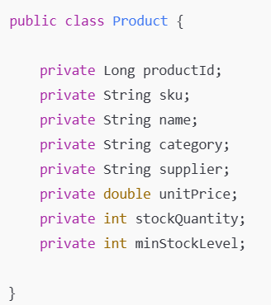
PRODUCT CLASS
This Product class represents a real product in inventory.
Each product has a unique SKU, price details, and stock quantity. Stock Quantity changes during stock-in and stock-out operations, and min StockLevel is used for alerts.

Slide 25
PRODUCT CONTROLLER
The Product Controller acts as the entry point for all product-related operations coming from the user interface. It follows the Controller layer of the layered architecture and is responsible only for handling HTTP requests.
The controller exposes endpoints for:
Adding new products
Increasing stock quantity
Decreasing stock quantity
It does not contain any business logic or database operations. Instead, it forwards requests to the Product Service. This design improves code clarity, reduces complexity, and ensures proper separation of concerns.

Slide 26
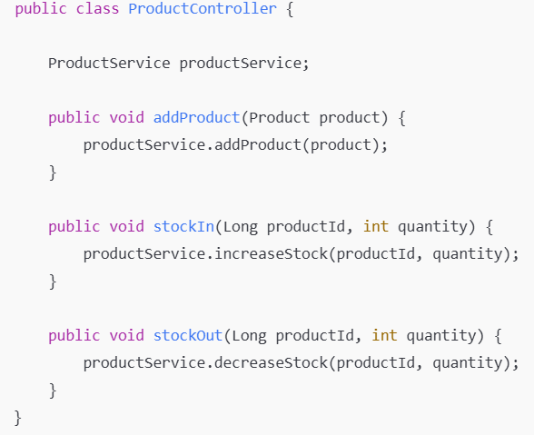
PRODUCT CONTROLLER
The controller receives requests from the UI.
It does not contain business logic.
It simply forwards the request to the service layer.

Slide 27
PRODUCT SERVICE
The ProductService is the most important component of Module 2 because it contains the core business logic. All validations and inventory rules are enforced here.
For example:
It checks whether a product SKU already exists
It validates stock availability before reducing stock
It ensures stock updates are performed safely using transactional methods
This layer also integrates with other services such as TransactionService and AlertService, making it the central point of coordination for inventory operations.

Slide 28
ADD PRODUCT OPERATION
When a new product is added to the system, the ProductService first checks whether the SKU already exists in the database. This validation is essential to prevent duplicate products, which can lead to incorrect stock calculations and reporting issues.
If the SKU is unique, the product is saved successfully. If not, the operation is rejected. This approach enforces data integrity at the database level and ensures that the inventory remains clean and reliable.

Slide 29
STOCK IN OPERATION
The Stock In operation is performed when new inventory arrives from suppliers. During this operation, the stock Quantity of the product is increased by the specified amount.
This operation is executed inside a transactional context, ensuring that the update is safely committed to the database. After updating the stock, the system logs the transaction for audit purposes and checks whether the stock level falls below the minimum threshold.
This ensures traceability, accountability, and proactive inventory management.

Slide 30
STOCK OUT OPERATION
The Stock Out operation is used when products are sold or consumed. Before reducing the stock, the system validates whether sufficient stock is available.
If the requested quantity exceeds the available stock, the operation is rejected to prevent negative stock values. If sufficient stock is available, the stock is reduced, the transaction is logged, and alerts are checked.
This mechanism ensures business rule enforcement, data consistency, and system reliability.

Slide 31
PRODUCT REPOSITORY
The ProductRepository is responsible for handling all database operations related to products. It uses Spring Data JPA to perform CRUD operations such as saving products, retrieving product details, and checking SKU uniqueness.
By isolating database logic in the repository layer, the system follows the separation of concerns principle, which improves maintainability and scalability. This abstraction also allows easy switching of databases without affecting business logic.

Slide 32
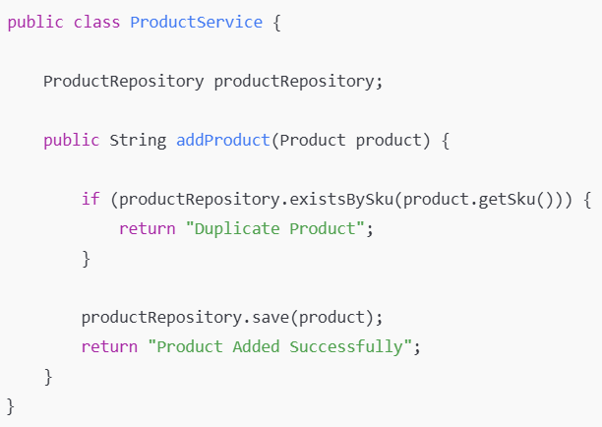
PRODUCT SERVICE
Before adding a product, we check whether the SKU already exists.
If it exists, we reject the request.
This prevents duplicate products in inventory

Slide 33
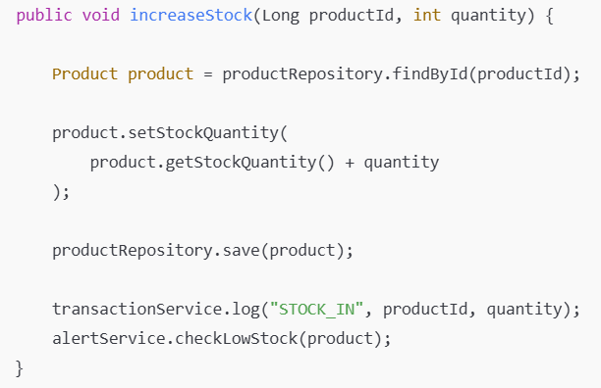
STOCK IN OPERATION
When new stock arrives, stock Quantity is increased.
The updated product is saved.
We log the transaction and check if alerts are needed.

Slide 34
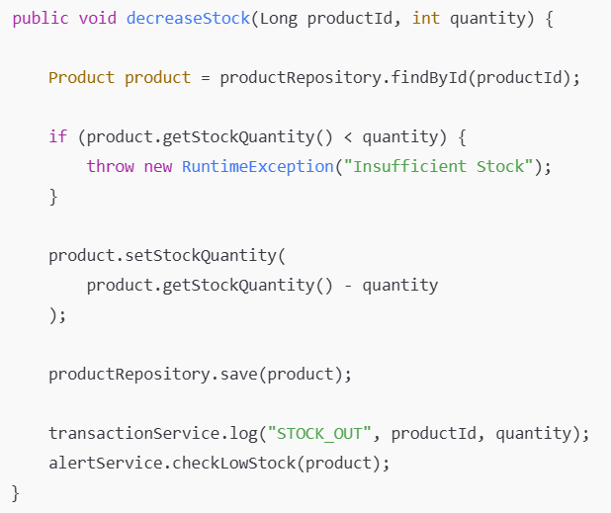
STOCK OUT OPERATION
Before reducing stock, we check availability.
If stock is insufficient, the operation fails.
This prevents negative stock values.

Slide 35
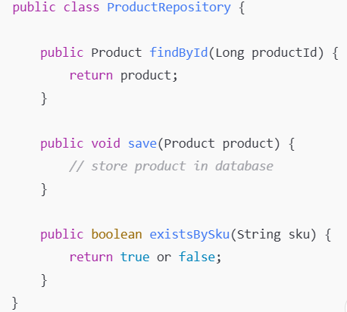
PRODUCT REPOSITORY
Repository handles database operations only.
Business logic is never written here.

Slide 36
MODULE 2 FLOW
UI
↓
Product Controller
↓
Product Service
↓
Product Repository
↓
Database

Slide 37
Inventra – Intelligent Inventory Management System
Milestone 3

Slide 38
MODULE 3
Introduction
The Inventory Alert Module is designed to automatically monitor stock levels and generate alerts when inventory falls below a predefined minimum level.
This module helps organizations avoid stock-out situations and ensures timely restocking.

Slide 39
Problem Addressed
Stock shortages are detected too late
Manual monitoring is error-prone
No automatic alert mechanism
Business operations get affected

Slide 40
Objectives of Alert Module
Continuously monitor stock levels
Compare current stock with minimum stock level
Trigger alerts automatically
Improve inventory reliability

Slide 41
When Alert Is Triggered
Alert is generated when:
Current Stock < Minimum Stock Level
Alert check occurs:
After stock-in operation
After stock-out operation

Slide 42
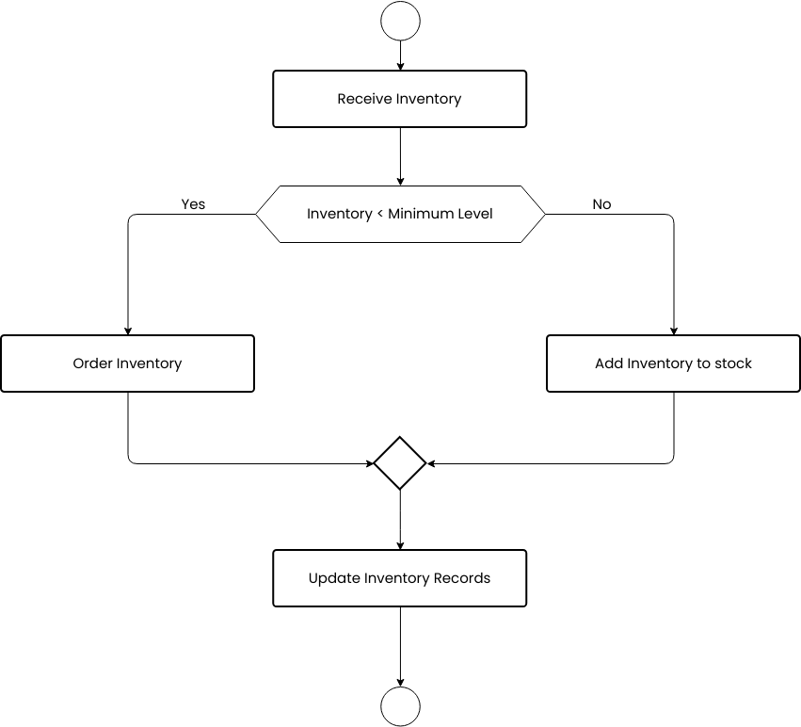
Flow Diagram

Slide 43
Java Code – Product Class
public class Product {
String productCode;
String productName;
int stockQuantity;
int minStockLevel;
public Product(String productCode, String productName, int stockQuantity, int minStockLevel) {
this.productCode = productCode; this.productName = productName; this.stockQuantity = stockQuantity; this.minStockLevel = minStockLevel;
}
}

Slide 44
NotificationService
public class NotificationService {
public static void sendAlert(Product product) {
System.out.println("⚠ ALERT!");
System.out.println("Product Name : " + product.productName);
System.out.println("Available Stock : " + product.stockQuantity);
System.out.println("Minimum Required : " + product.minStockLevel);
System.out.println("Please restock immediately.");
}
}

Slide 45
AlertService
public class AlertService {
public void checkLowStock(Product product) {
if (product.stockQuantity < product.minStockLevel) {
NotificationService.sendAlert(product);
} else {
System.out.println("Stock level is sufficient for “+ product.productName);
}
}
}

Slide 46
InventoryAlertDemo
public class InventoryAlertDemo {
public static void main(String[] args) { // Create product with low stock
Product product = new Product( "PR101", "Cricket Bat", 5, // current stock 10 // minimum stock level );
// Alert service
AlertService alertService = new AlertService();
alertService.checkLowStock(product);
}
}

Slide 47
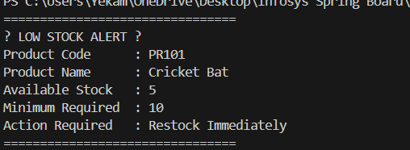
Expected Output

Slide 48
Inventra – Intelligent Inventory Management System
Milestone 4

Slide 49
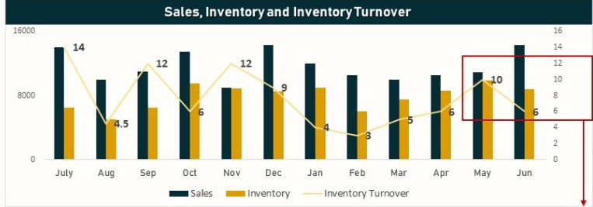
Module 4: Reports & Analytics
Purpose of Reports & Analytics
Reports & Analytics converts raw inventory data into meaningful information.
It helps managers understand stock levels, identify trends, and make better decisions.

Slide 50
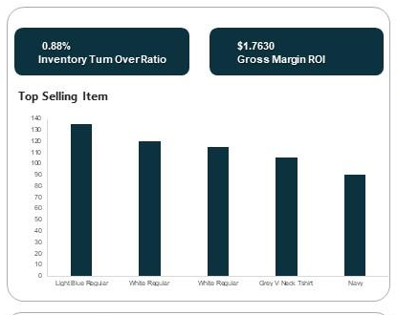
Objectives
Generate inventory summary report
Identify highest stock product
Identify lowest stock product
Display total stock information”

Slide 51
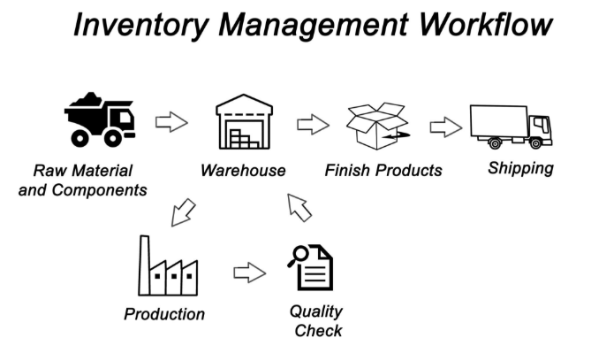
Flowchart – Reports & Analytics Process
START
|
Load Inventory Data
|
Calculate Total Stock
|
Find Highest Stock Product
|
Find Lowest Stock Product
|
Display Reports
|
END

Slide 52
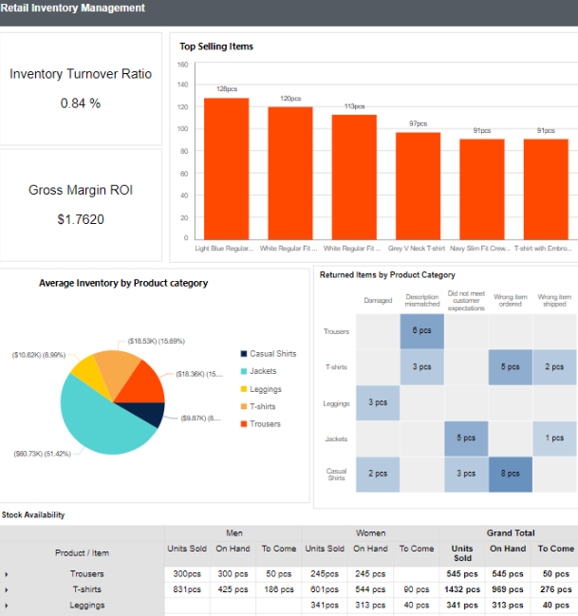
Types of Reports Generated
Inventory Summary Report
Total number of products
Total stock available
Highest Stock Product
Helps detect overstocked items
Lowest Stock Product
Helps reorder items early

Slide 53
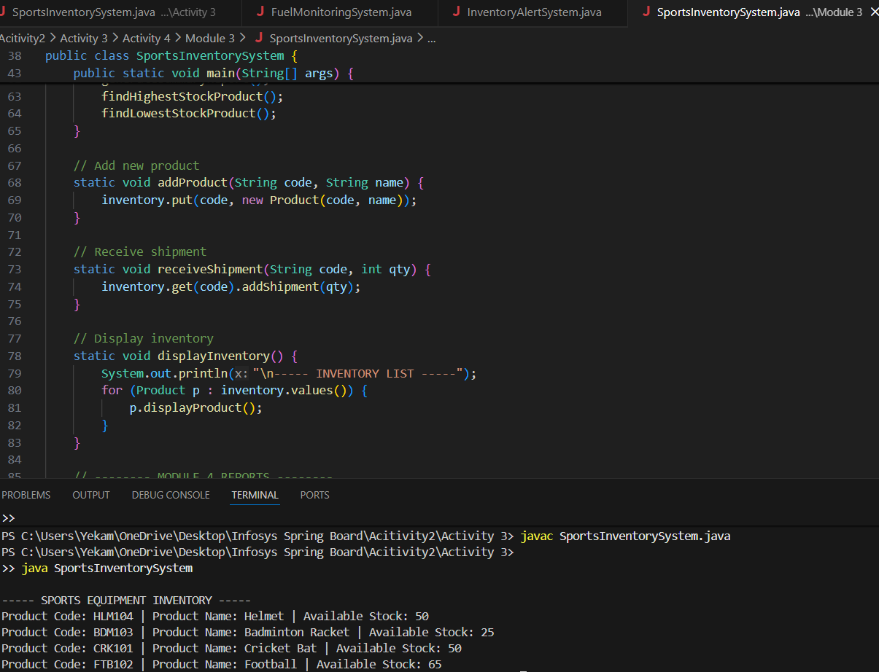
Code – Inventory Summary Report
static void generateSummaryReport() {
int totalItems = 0;
for (Product p : inventory.values()) {
totalItems += p.totalStock;
}
System.out.println("\n----- INVENTORY SUMMARY REPORT -----");
System.out.println("Total Number of Products : " + inventory.size());
System.out.println("Total Stock Available : " + totalItems);
}

Slide 54
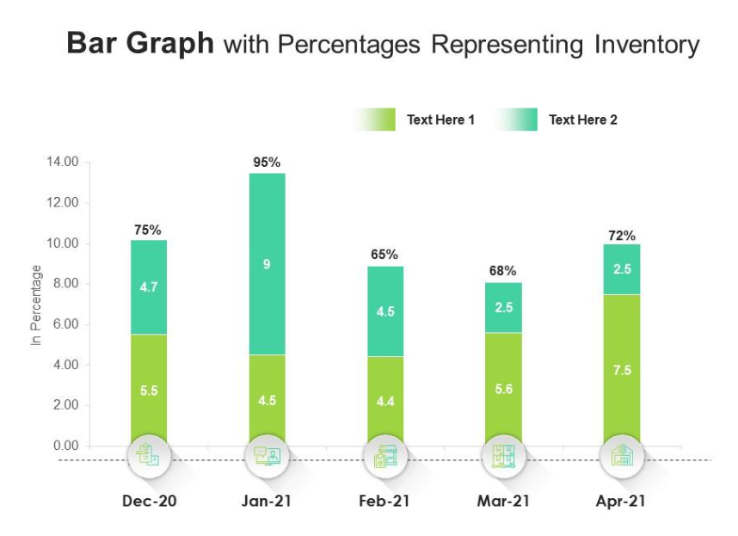
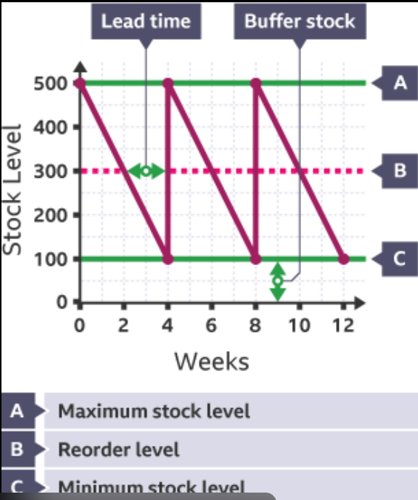
Sample Output

Slide 55
Conclusion
Reporting and analytics features to the inventory system.
It transforms stored inventory data into meaningful business insights.

Slide 56
Thank you

